Slide 1
Analyzing Reviews for User Expertise
Akanksha Nichrelay
Arjun Malhotra
Michael A. Klaczynski

Slide 2
The Problem
Anyone can submit online shopping reviews
Not all users are equally knowledgeable about products therefore,
Not all reviews are equally helpful
Notes:
Here we can discuss examples of helpful versus unhelpful reviews.
TODO: Prepare some examples

Slide 3
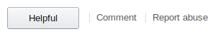
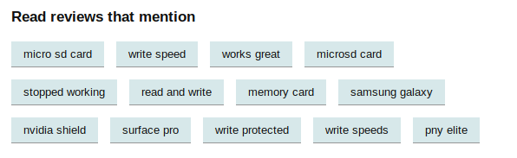
Amazons Reviews
User Feedback
Sort by Key Phrases
Notes:
Let’s take a look at the current state of the Amazon Review system...

Slide 4
Question
“How can we rate the ‘Intelligence’ of reviews?”
Notes:
Elaborate on what we mean by this.
“Now what do we mean by this? What we really want are reviews that use intelligent language. This usually means words that are not found in everyday conversation, but words that are only really used when discussing a certain specific topic, such as [the product at hand] that indicate that the writer or speaker knows what they are talking about. But I’m getting ahead.”
“At the end of the day, we want reviews that adequately inform the user.”

Slide 5
Uses
Review Retrieval
Prioritize showing detailed reviews
Profiling
Track users’ areas of expertise
Reward good reviewers
Notes:
Retrieval
-Thousands of Reviews, which ones are good?
Profiling

Slide 6
Approach
Use unsupervised learning to group similar reviews.
Similarity of reviews measured by different approaches
Evaluate clusters against our annotated data - the tech blog data

Slide 7
Data
We chose reviews of Micro SD card out of all the electronics product reviews-
About 5,000 reviews for the item.
SanDisk Ultra 64GB MicroSDXC Class 10 UHS Memory Card Speed Up To 30MB/s With Adapter - SDSDQUA-064G-U46A
https://snap.stanford.edu/data/#reviews
For evaluation:
Manually extracted data from a techBlog.
https://www.techspot.com/guides/1591-microsd-buying-guide/

Slide 8
Experimentations

Slide 9
Data processing
Used NLTK libraries.
Tokenizing
Stemming
Normalization
Length and Lowercase filter
Stopword removal
Allowed relevant words to bypass
‘GB’, ‘KB’, ‘FAT32’, ‘UHS’, etc

Slide 10
Algorithms we used for clustering
K-Means Clustering
Representation of Documents into vectors using -
Bag-of-Words
Tf-idf
Average Word2Vec
Tf-idf Word2Vec
Evaluate each cluster against the ground truth to access user intent.

Slide 11
Bag Of Words
Unfortunately, BoW did not yield clearly distributed
clusters. Most of the data points are concentrated in one of the clusters.

Slide 12
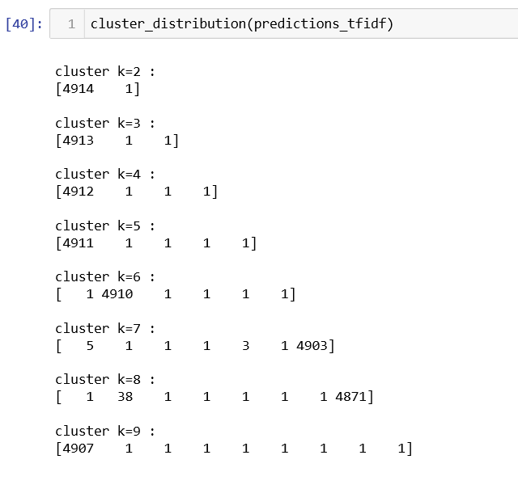

Slide 13
Did simple TF-IDF would make a difference ?
Similar to BoW, K-Means on Tf-idf doesn’t generate well separated clusters. Most of the reviews are concentrated in a single cluster.

Slide 14
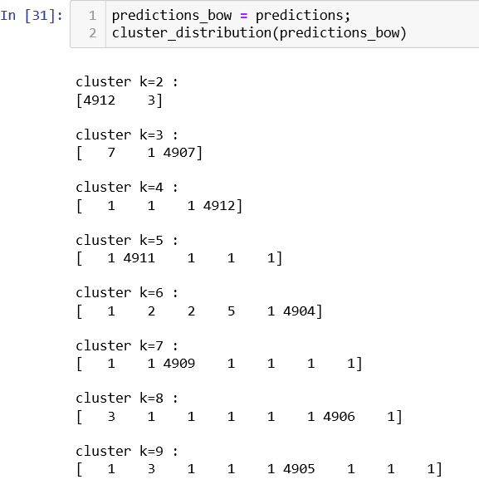

Slide 15
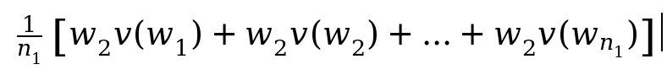
Average Word2Vec
Word2Vec does a better job of segregating reviews into distinct clusters as compared to BoW and Tfidf.
Almost all the clusters have sizeable number of reviews in them.

Slide 16
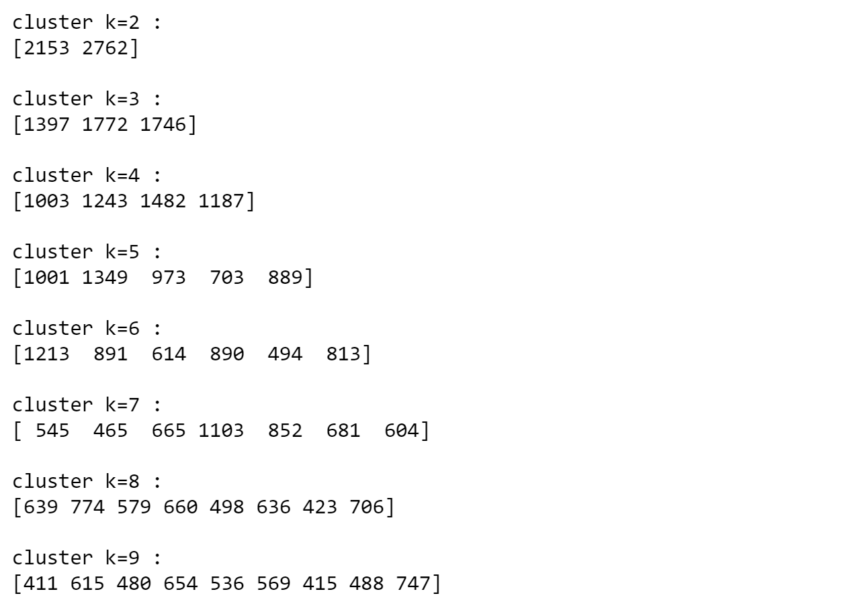

Slide 17
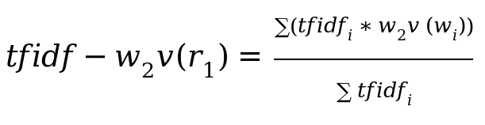
TFIDF Word2Vec
Unlike BoW and Tfidf, the reviews are more evenly distributed across clusters.

Slide 18
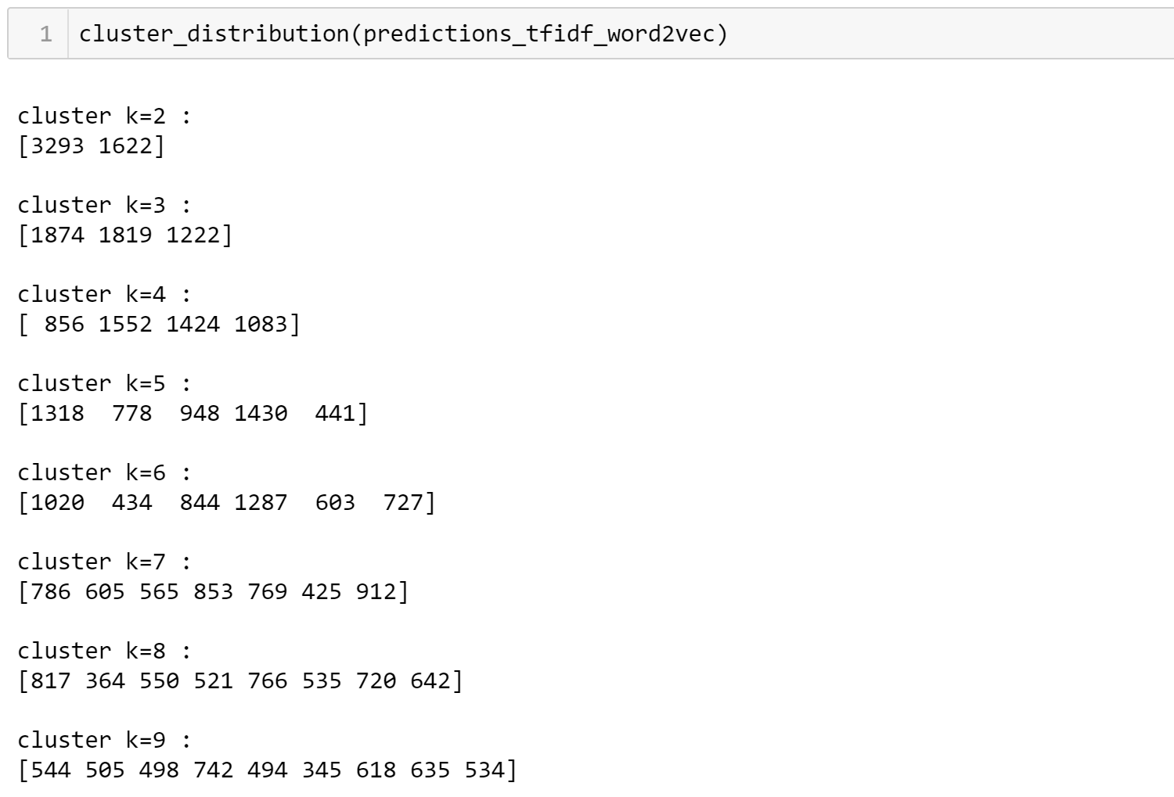

Slide 19
Evaluation
Two Approaches
We check average count of relevant terms in the clusters.
(Sum of relevant words in all review of a cluster) / (Total reviews in the cluster)
We calculate the average TF-IDF of all the relevant words in the reviews.
(Sum of TF-IDF of relevant words in all reviews of cluster) / (Total reviews in the cluster)
Human Judgement was used to interpret the final results.

Slide 20
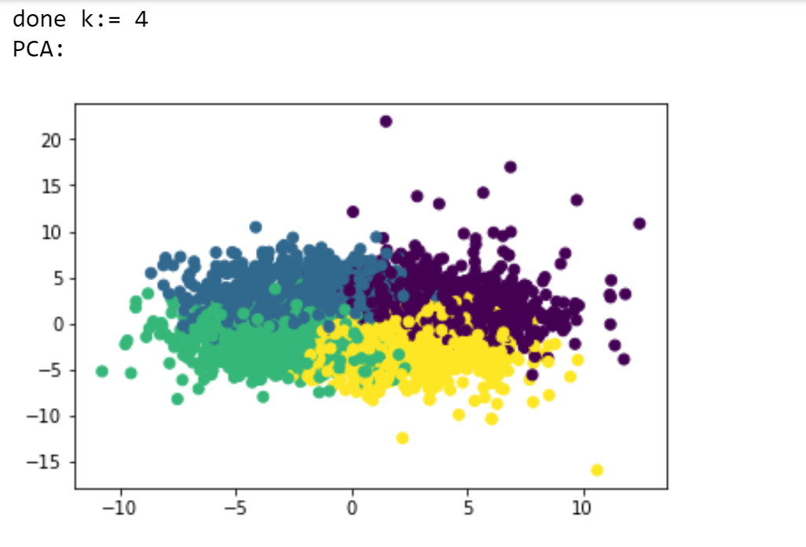
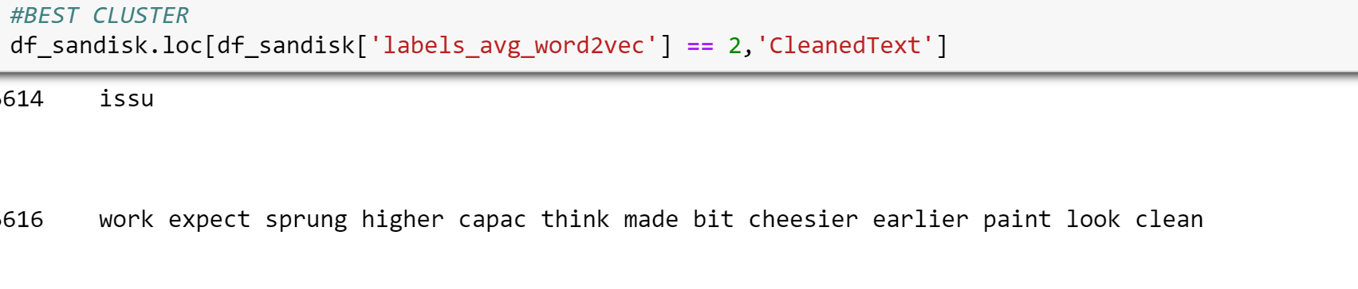
Using Avg Word2Vec
Elbow curve gives best clustering with k= 4.
Used average relevant words count to evaluate.
Results were judged manually.

Slide 21
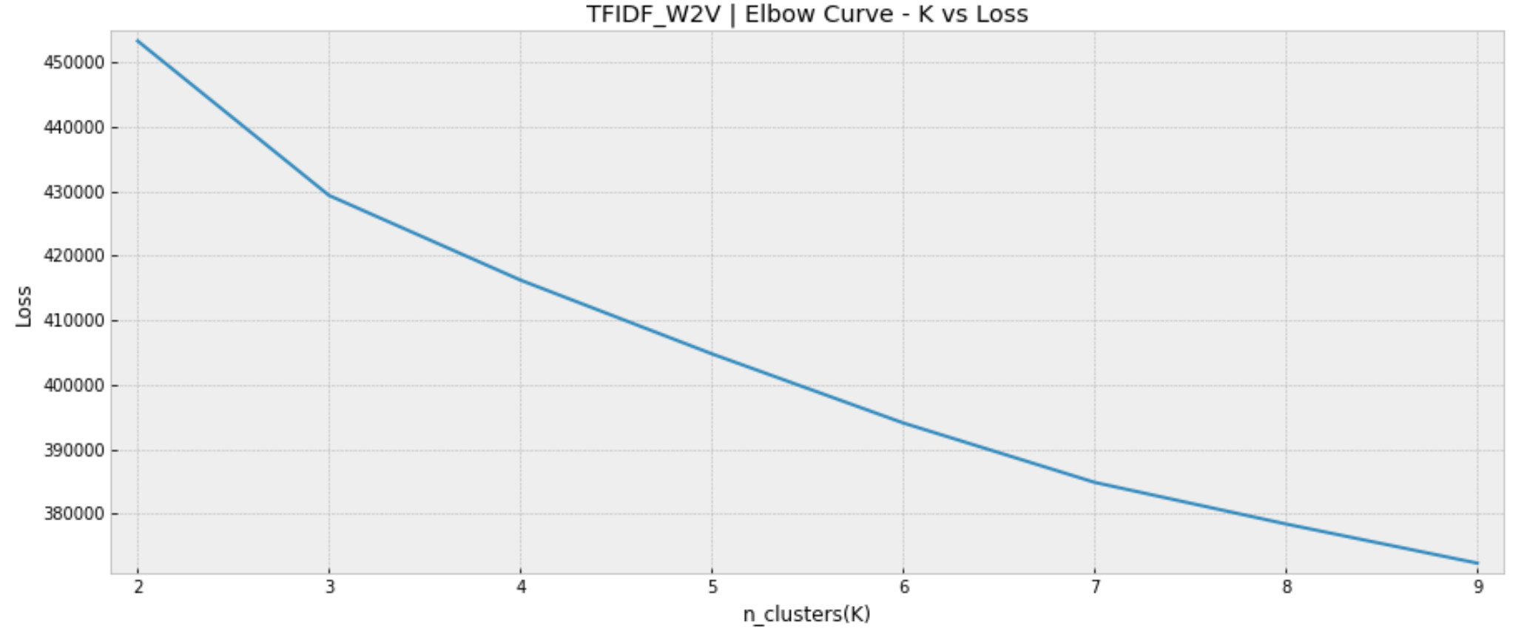
Using TF_IDF Word2Vec
TF_IDF Word2Vec gives the best clustering.
Elbow occurs for k=3

Slide 22
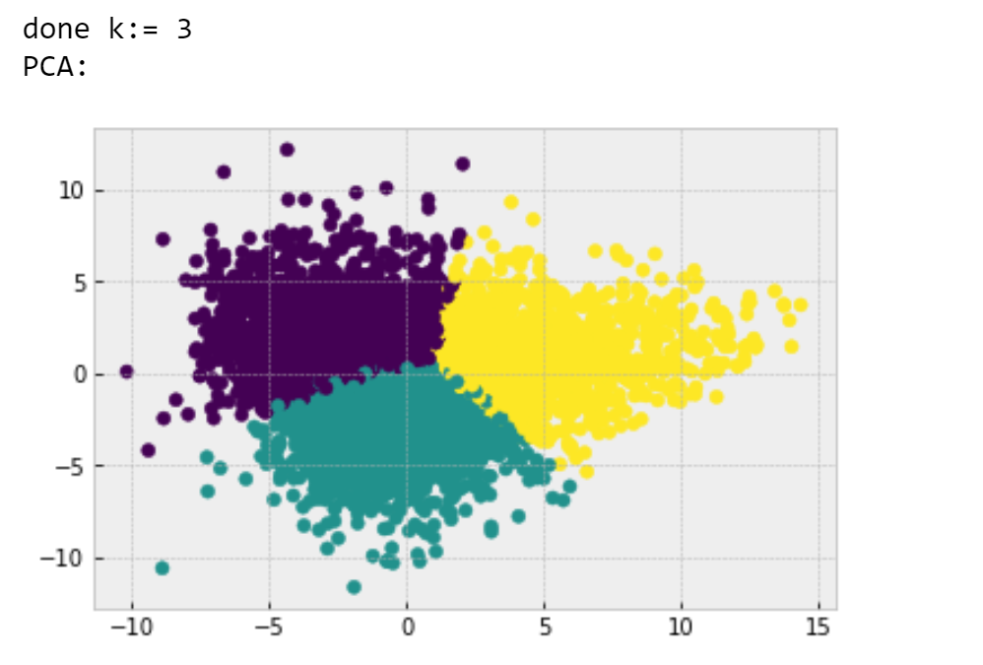
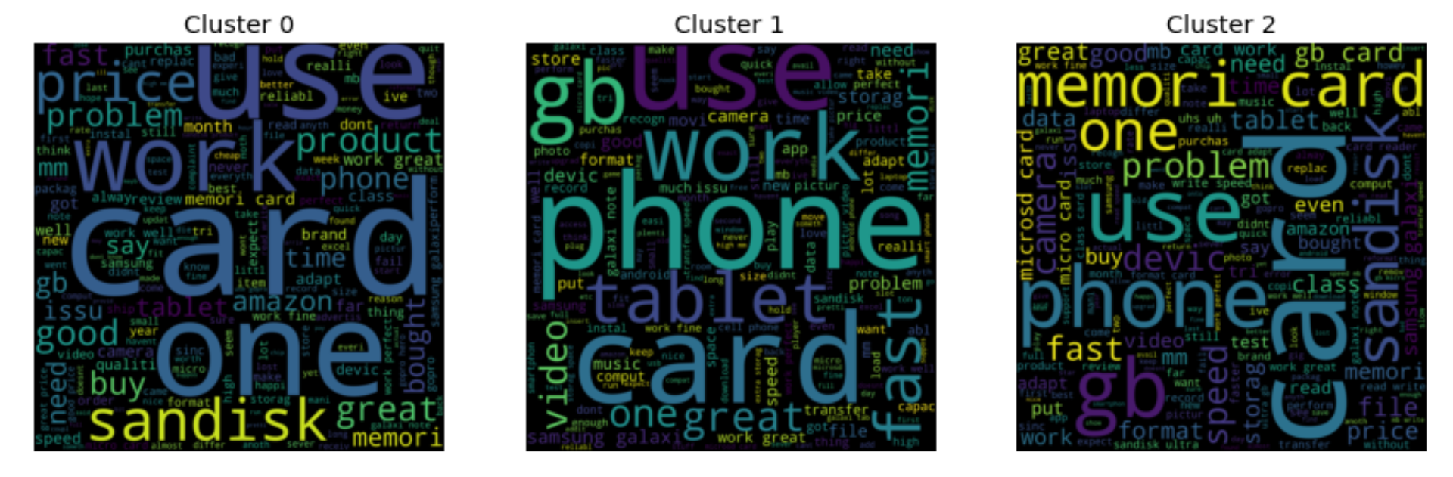
TF_IDF Word2Vec
Some words could be filtered out.

Slide 23
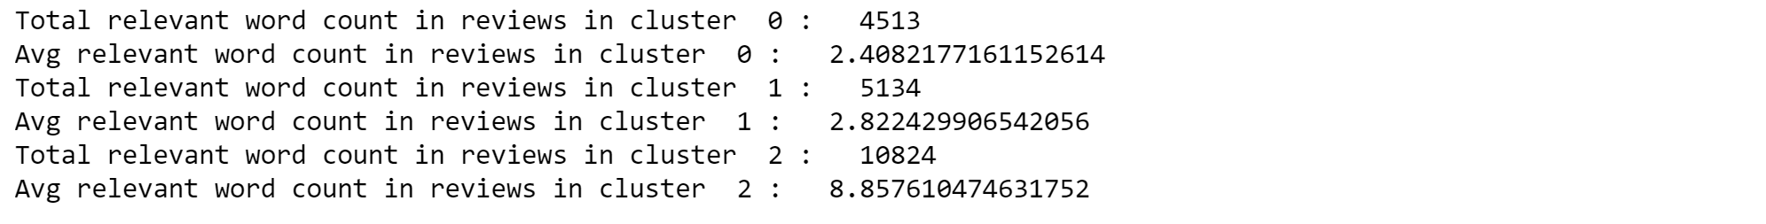
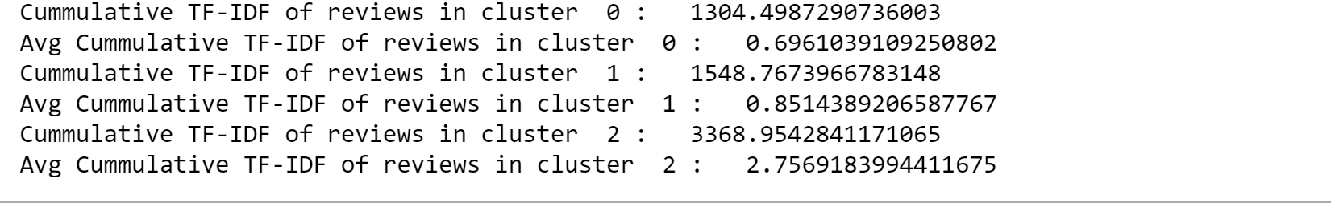
Same results from both evaluations
← Less Intellectual
← More Intellectual
← Less Intellectual
← More Intellectual

Slide 24
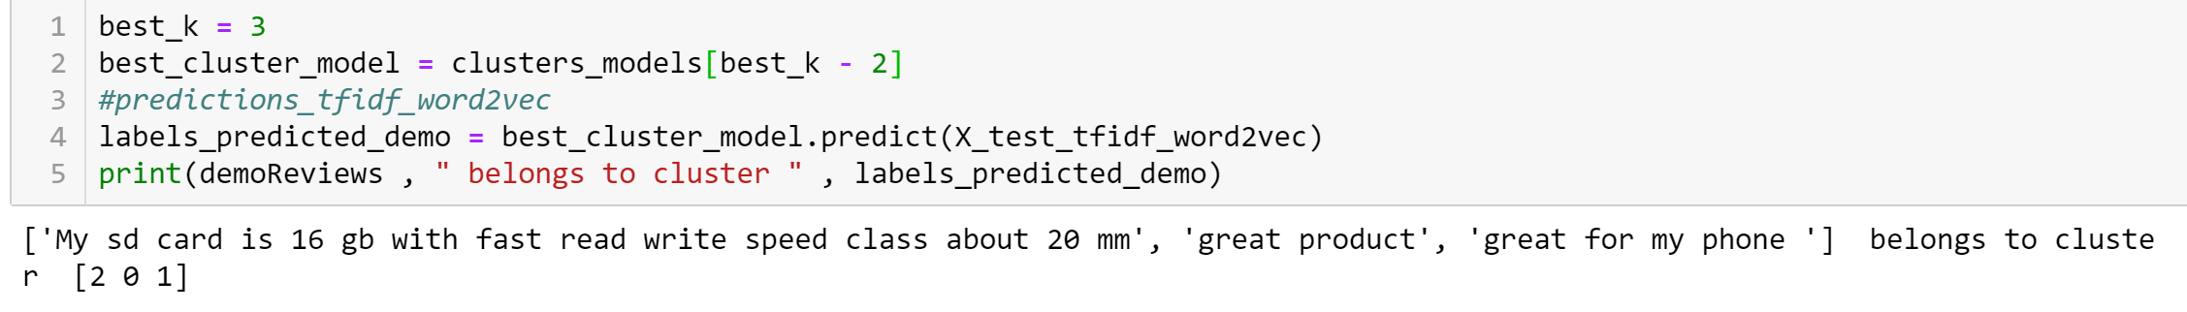
Predictions on Fresh Reviews
Results were mapped to expected cluster
Still scope for improvement.

Slide 25
Results
We can find user intellectual level by clustering the similar reviews together.
TF-IDF word2Vec works really well in grouping reviews
Cummulated TF-IDF of relevant words gives better results than normal count of relevant words.

Slide 26
Future Research
Generalize to any topic.
Try on different products.
Better Evaluation - Rankings based on Intellectuality.
Use Expert file as a document to measure similarity from cluster.
More clusters can be used for more levels of knowledge.
Deep Learning - Thought Vectors and Sentence2Vector.

Slide 27
Questions?

Slide 28
Algorithms we didn’t use for clustering
DB-SCAN (Density Based Clustering).
Hierarchical Clustering.
WHY ?
They do not cluster well with high number of dimensions.
Notes:
Should come towards end - only if we have time. Or for Q&A.

Slide 29
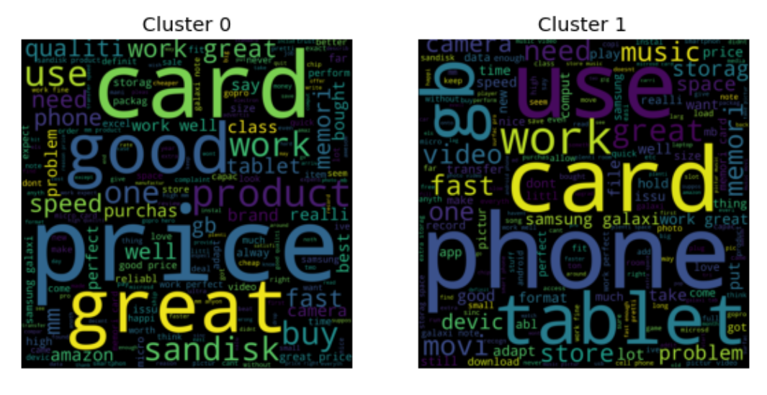
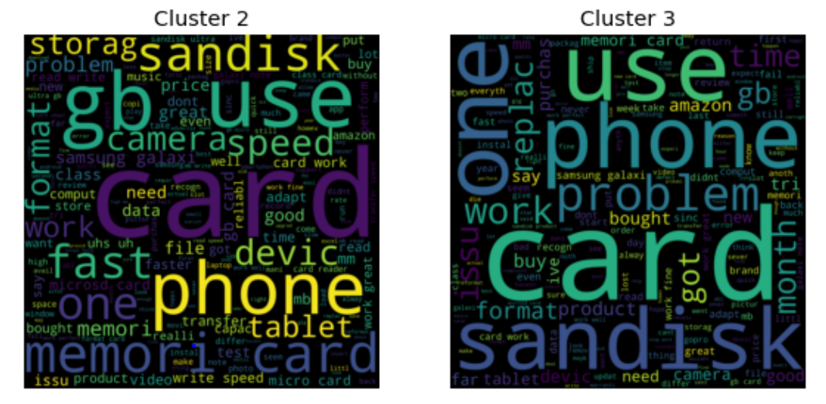

Slide 30
